Slide 1


Innovative Partnerships for Equity: The case of Equitable Education Fund
UNLEASHING THE POWER OF DATA AND EVIDENCE FOR EQUITY AND EQUALITY IN EDUCATION IN ASEAN
Kraiyos Patrawart, PhD
Deputy Managing Director
Equitable Education Fund (EEF)
kraiyos@eef.or.th

Slide 2

มาตรา 258 (จ)
ให้ดำเนินการตรากฎหมายเพื่อจัดตั้งกองทุนตามมาตรา 54 วรรคหกให้แล้วเสร็จภายในหนึ่งปีนับแต่วันประกาศใช้รัฐธรรมนูญนี้
Article 54 of the Constitution of the Kingdom of Thailand BE 2560 requires Thai Government to establish Education Fund with 3 specific objectives:
To Support Poor and Disadvantaged Populations
To Improve Equity in Education
To Promote Teacher Quality and Efficiency
Article 54 also requires the Fund to be independently managed and financed by the government funding and donations with special tax incentive.
Thailand’s
New
2017 Constitution
Country Reform on Education
Inequality is the top priority
“Equitable Education Fund”

Slide 3













EEF’s Strategic Target Groups
5
Teachers who teach children and adolescents in Group 2 – 4
6
Poor Late Adolescents (Age 18-25) who need work-based skill training 0.15 million
2 million
2.3 million
7.1 million
2.4 million
3.1
Poor Students in kindergarten
0.61 million
(26%)
Students in Compulsory School
6.9 million (97%)
3.3
Poor Students in
High School (Gen/Vac)
0.36 mil (15%)
1
3.2
Poor Students
1.8 million (25%)
Disable Students
0.34 mil (5%)
Infant
0.77 million
(40%)
2.1
4
Pre-school OOSC 0.23 million (10%)
2.2
0.2 million
(3%)
Dropouts (After Grade 9)
0.24 million (10%)
Comp. School OOSC
Infant 0-2
Pre-school 3-5
Compulsory School Age 6 – 14
Adolescents 15 - 17
Source: Calculate from Civil Registry Data from Ministry of Interior and Student Registration from Ministry of Education

Slide 4










Equitable Education Fund’s 7 Strategies
Independently Managed by the EEF Board
EEF-17-member-Board is chaired by the independent and distinguished chairperson and 7 independent experts
(Education, Private Sector, NGOs) appointed by the cabinet. EEF’s CEO is also a member and secretary of the board
1
2
Using Information Technology to connect 13-digits databases from 6 ministries to identify and monitor
EEF uses state-of-the-art information technology to identify, support and monitor all target groups, using 13-digits number, to ensure a complete identification and near-real-time tracking the target group. EEF will also connect all databases of 6 ministries to work together
Using individual-based information to support Demand-side Financing approach
EEF will use state-of-the-art information system to individualized package, both in cash and in kind, for children and youth based on their actual needs for the genuinely “Equitable Educational Outcomes”.
3
4
Using FinTech and EdTech as well as Good Governance to ensure full transparency and accountability of the fund management
EEF will combine both technology and good corporate governance to ensure full transparency and accountability of its management of fund
5
Promote multi-sectoral, both at local and national levels, and multi-national collaborations
EEF work closely with both public and private organizations at local and national levels across sectors as well as multi-national partners to help achieve the Fund’s objectives
6
Matching government funding with the fund raising campaign to multiply impact of EEF Program
EEF’s legislation authorizes EEF to give 2 times tax incentive to individuals and companies to donate money for EEF programs. Therefore, EEF can match government and private funding to multiply the program’s impact to target groups.
฿
G
7
Establish Equitable-focused partnership at local, national and international levels
EEF is currently working on starting a network of “Equity-focuses” organizations at both national and international levels to help connect the knowledge and experience of equitable education program across the globe.

Slide 5






Focus on Equitable Outcome, not inputs
Equal inputs, inequality remains
Targeted inputs => equitable outcome
Status Quo, inequality getting worse

Slide 6
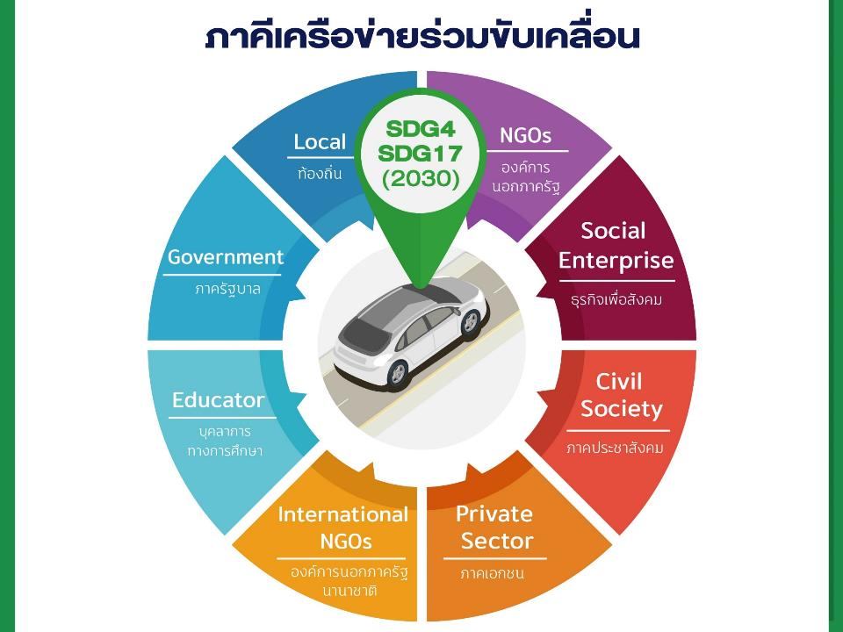
All for Equitable Education

Slide 7


To get the last out-of-school children back to education,“All for education” is a key.
The last 5-10% of children
remains out of school.
Innovative approaches and stakeholders engagement are crucial for achieving equitable education.
Equitable
Education
7

Slide 8

EEF’s OOSCY Strategy
Preventive Measures
- Prevent occurrence of OOSCY using CCT and strategic scholarship
Corrective Measures
- Resolve OOSCY’s factors using area-based intervention
- Prevent recurrence of OOSCY
Cost-efficient and should be the main intervention in the long run
Highly Costly but necessary in the early stage, then shift to monitoring system

Slide 9
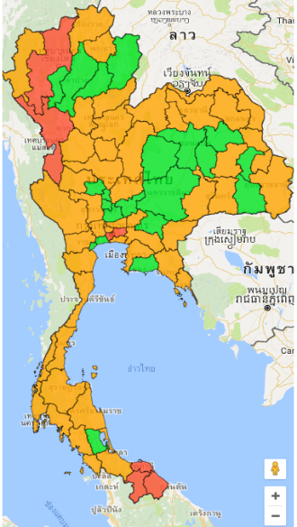
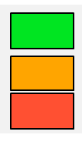
EEF’s Program for Out-of-school Children and Youth
Estimated number of out-of-school Children and Youth
= no. of children and youth (3 -17 years old) - students
2015 Estimate of Thai OOSCY
The number of children and youth age between 3 and 17 years old (Data from household registration) | 9,805,469
Students (MOE schools) | 8,661,730
Students (DLA schools) | 551,343
OOSCY (3-17 Years) | 592,396
% | 4.14
OOSCY < 4% :
OOSCY 4-8% :
OOSCY > 8% :
หมายเหตุ:
1. ข้อมูลนักเรียนสังกัดกระทรวงศึกษาฯ จากศูนย์เทคโนโลยีสารสนเทศ สป.ศธ. (มิ.ย. 2558)
2. ข้อมูลทะเบียนราษฎร์ จากศูนย์เทคโนโลยีสารสนเทศ สป.ศธ. (ปี 2558)
3. ข้อมูลนักเรียนสังกัดอปท. จากเวปไซท์ระบบสารสนเทศการจัดการศึกษาท้องถิ่น (มิ.ย. 2558)
ที่มา: โครงการหลักประกันโอกาสทางการศึกษาฯ, ศ.นพ.ศุภสิทธิ์ พรรณนารุโณทัย และคณะ
9

Slide 10
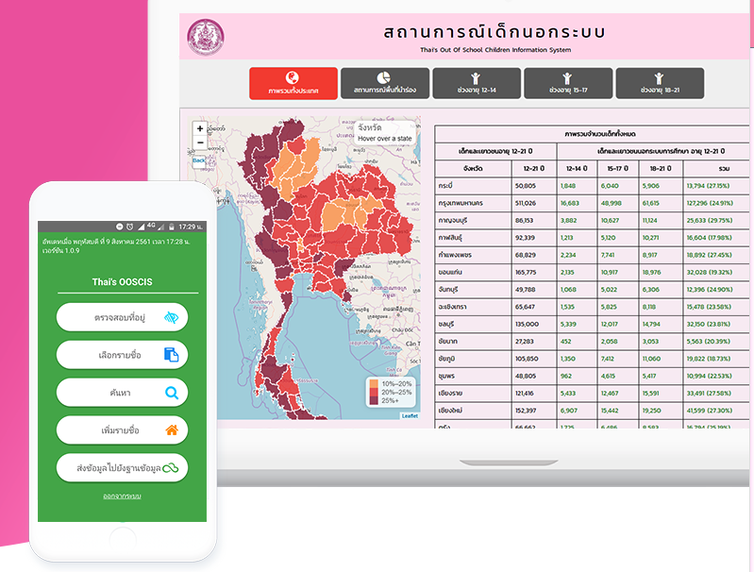

Slide 11
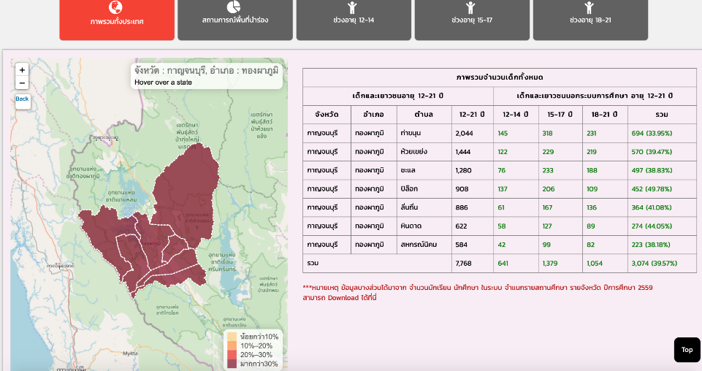
District-level Database for
Community-based Survey

Slide 12

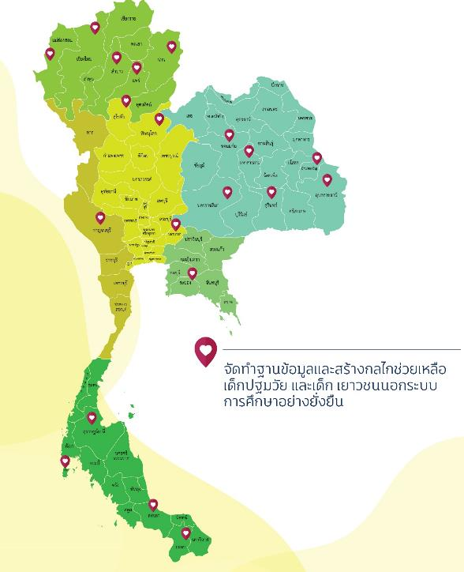

Piloting 20 Provinces using Area-based Approach
Multi-sectoral Platform for OOSCY
OOSCY Provincial Database
Community-based program to identify and support OOSCY using latest smartphone technology
จังหวัดดำเนินงาน
12

Slide 13


Changing from functional-based to Target-based approach
Function-based
Target-based
Area-based integration (Chaired by the Governor)
MOI
MOE
MSDHS
MOPH
Labour
โครงการไม่เน้นปฏิบัติการซ้ำซ้อนกับหน่วยงานหลัก เน้นความร่วมมือบนฐานข้อมูลและความร่วมมือทางวิชาการ
13

Slide 14








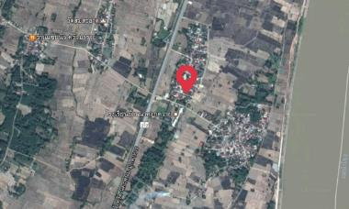
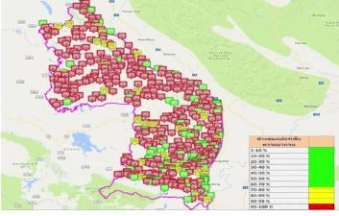


Equity-based Budgeting: Thailand 1st Conditional Cash Transfer

Slide 15

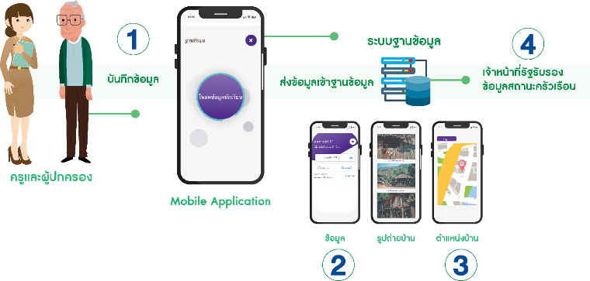


Using EdTech and FinTech to help teachers collect data for PMT
1. Teacher visit student’s home with Smartphone
2. Using CCT’s App to collect household’s data on income and asset ownership
3. Using CCT’s App to collect geographical and graphical data of household
4. Head Village certify the data by e-signing in CCT’s App

Slide 16
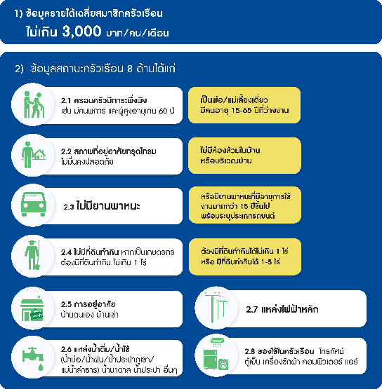

Innovation on Poverty Screening
Proxy Means Test

Slide 17
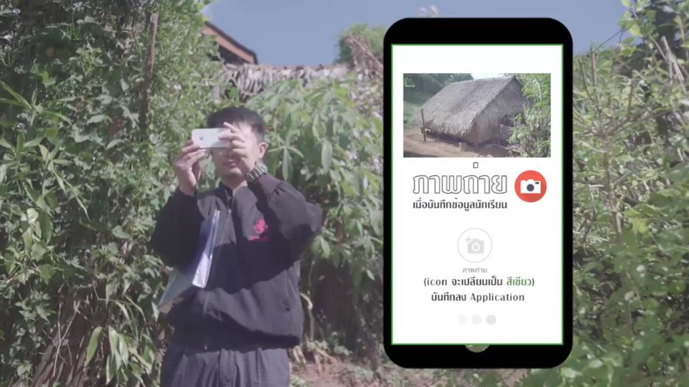
Teacher take photo from smart phone

Slide 18
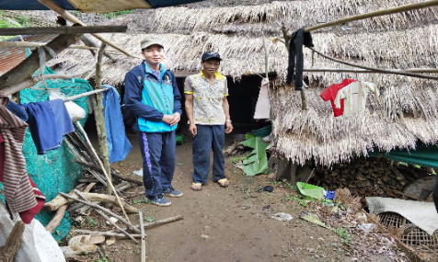
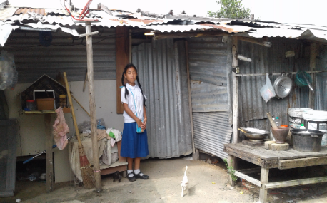
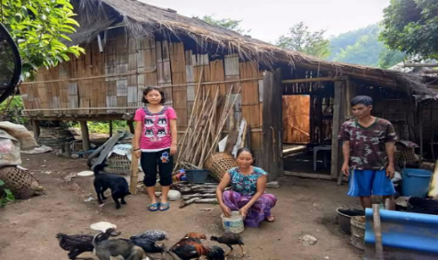
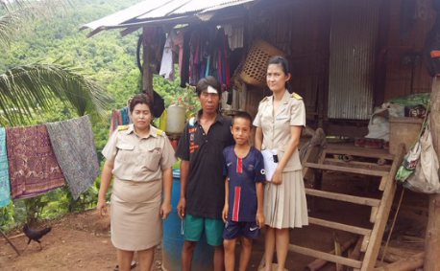
Example of Poor Students’ household

Slide 19
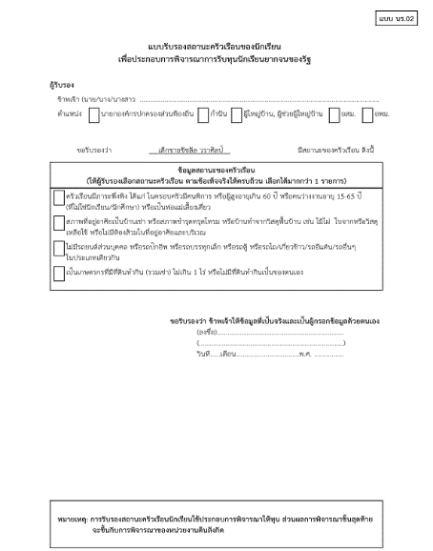
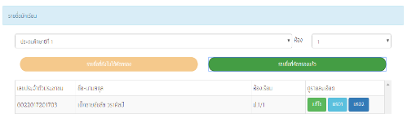
3 parties approval
3 Parties
Family
Teachers
Village leaders

Slide 20




School committee review and approve data and develop activities
EEF
Approve
School Committee
Review and Approve
Verify data and allocate fund
Chairman of the committee
School Director
Civil Society
Local government officer
Teacher

Slide 21
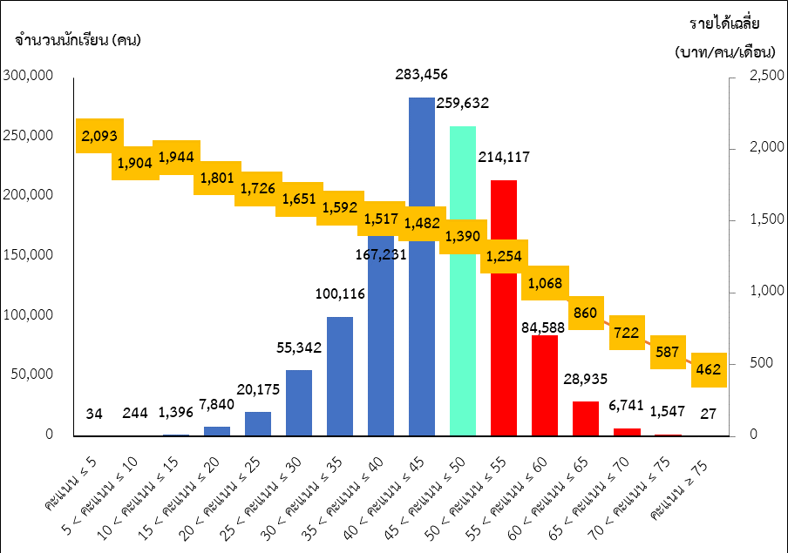

Slide 22

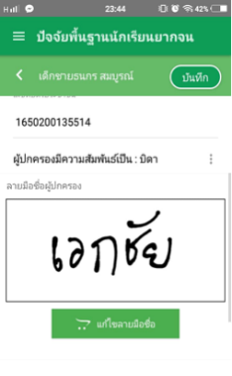

Using FinTech to process the CCT payment

Slide 23
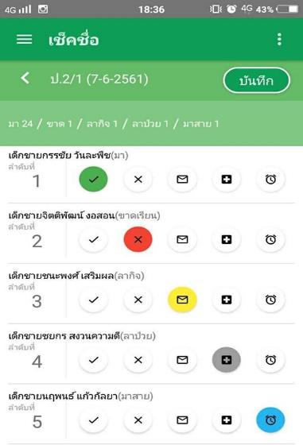
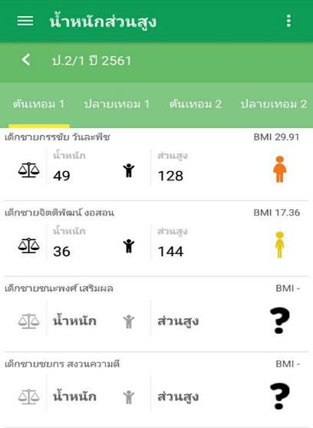
Conditional Cash Transfer (CCT)
(1) School Attendance > 80% & (2) Normal BMI

Slide 24
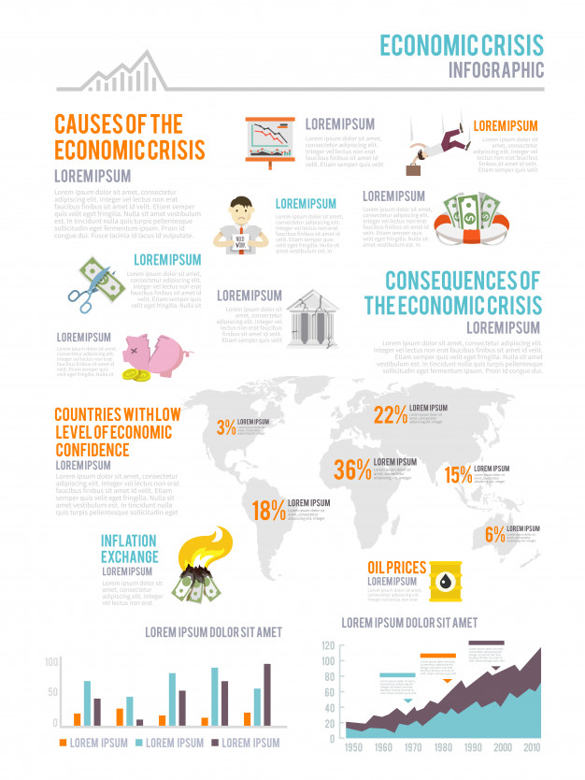
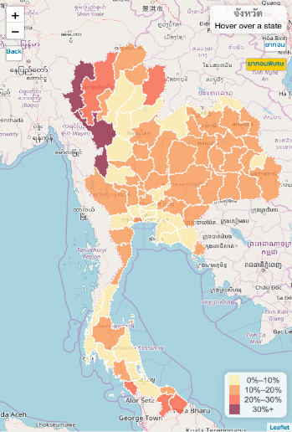
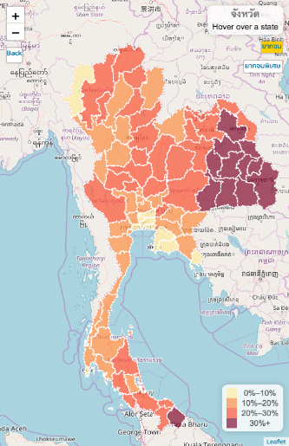
Where are the poor students ?
Extreme Poor Students
Poor Students

Slide 25
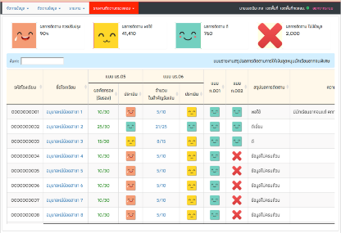
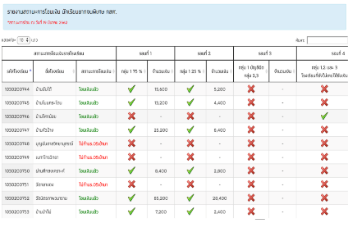
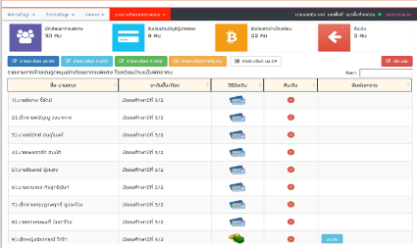
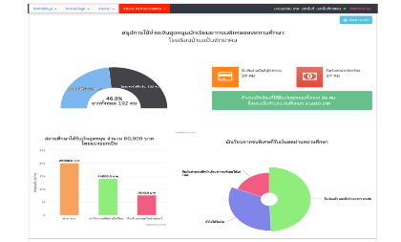
EEF and MOE use CCT’s intelligence to plan and implement long-term program to improve equitable education in Thailand
ตรวจสอบการบันทึกข้อมูล
ตรวจสอบสถานะการโอนเงิน
ช่องทางการรับเงินของนักเรียน
สรุปข้อมูลภาพรวมของ รร.

Slide 26
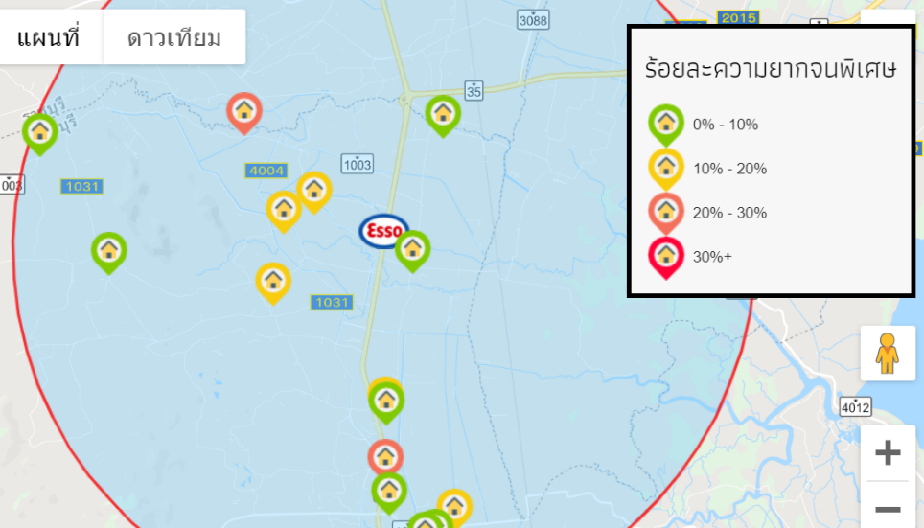
Big Data Applications: Fund Raising Campaign

Slide 27
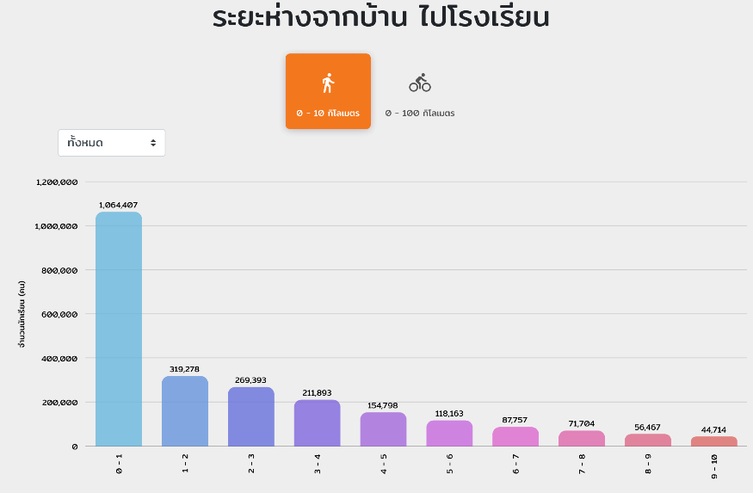
Big Data Applications: School Mapping/Bussing

Slide 28
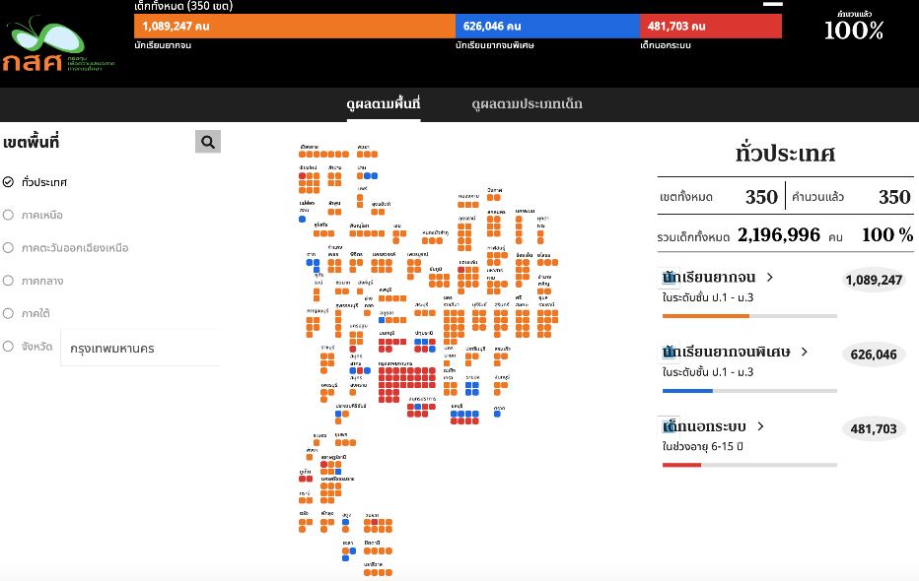
Big Data Applications: Public Participation

Slide 29

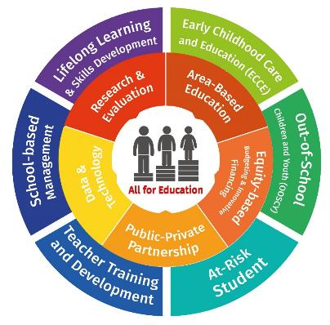

Theme:
All for education
Sub-theme:
Area-based education
Innovative financing & Equity-based Budgeting
Public-Private Partnership
Data and technology for equitable education
Research and Evaluation
Session 6: Consultation on the 2nd Ministerial Conference on SDG 4, 2020

Slide 30


The International Conference on Equitable Education: All for Education
Pre-Conference
Press Conference “The International Conference on Equitable Education: All for Education”
The International Symposium “Lesson Learnt from UNESCO Learning Cities: Area-Based Approaches to All for Education”
The International Conference on Equitable Education: All for Education
Oct-Nov
2020
Registration
Sep 2020 onward
Working group meetings with International Co-Hosts eg. UNESCO, UNICEF, Save the children
International EEF Network Conference
May – Sep
2020
2nd Ministerial Conference on SDG
Dec 2019-Mar 2020
May-Aug 2019
Sep 2019
Oct-Dec 2019
Post Conference
Oct 2019 – Apr 2020
Follow up key issues from the conference
Policy Movements
International networks
4 Regional workshops under the theme “Area-Based Education”

Slide 31

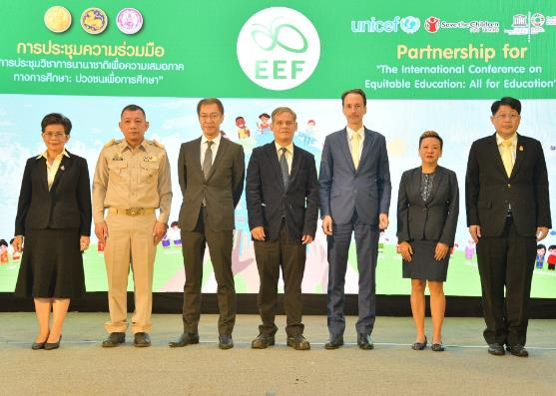
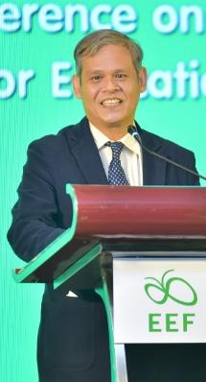
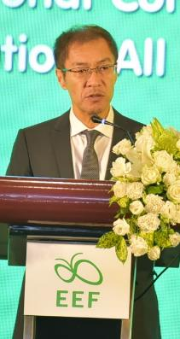
Press Conference
The International Conference on Equitable Education: All for Education

Slide 32



Thank you
very much
More information:
research.eef.or.th
EEFthailand
Investing to expand more
equitable educational opportunities

